Slide 1
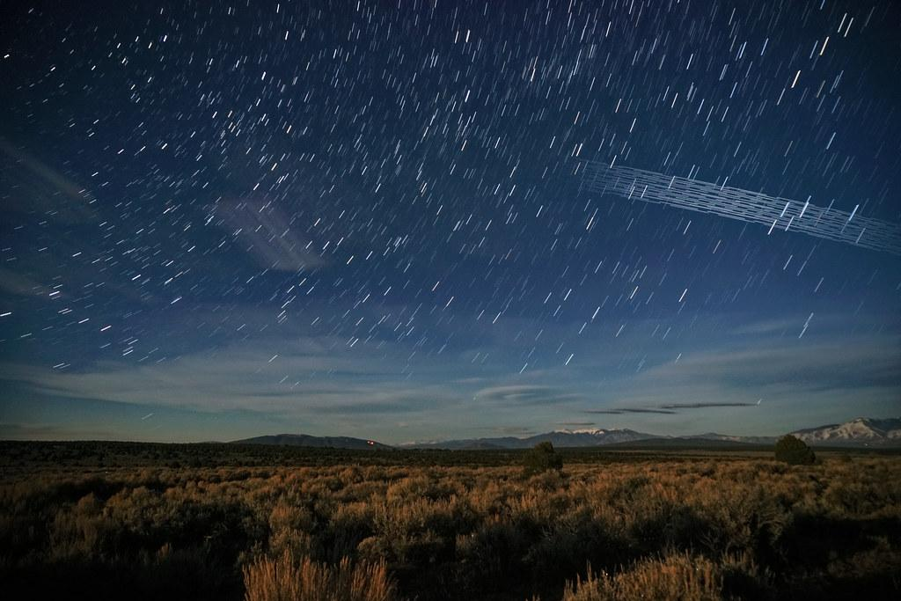
Astrometry 2020
Satellite Constellations
Dinosaurs killer asteroids
Gaia-Nyx

Slide 2
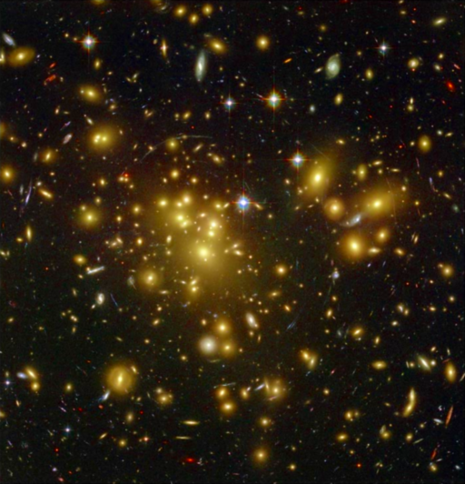
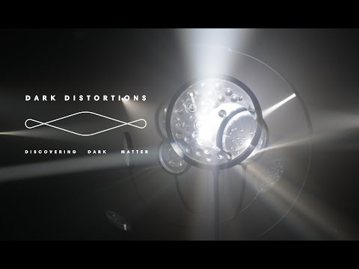
Team:
Mariano Dominguez
Marcelo Lares
Emmanuel Gianuzi

Slide 3
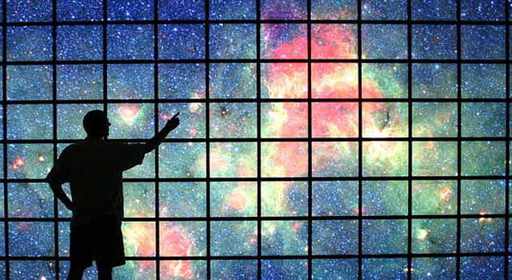
AstroStatistics
2020 [1909.07976] Cosmological Simulations of Galaxy Formation
ADS search of machine learning
Google trends on DS, ML, CV, NN, and DL

Slide 4
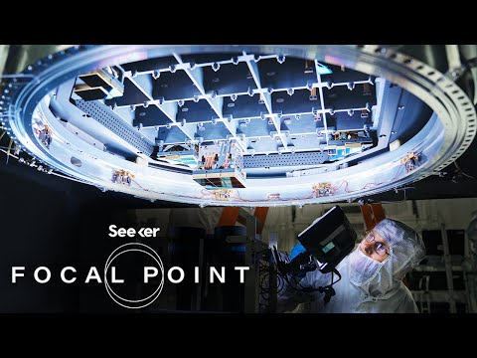

Slide 5
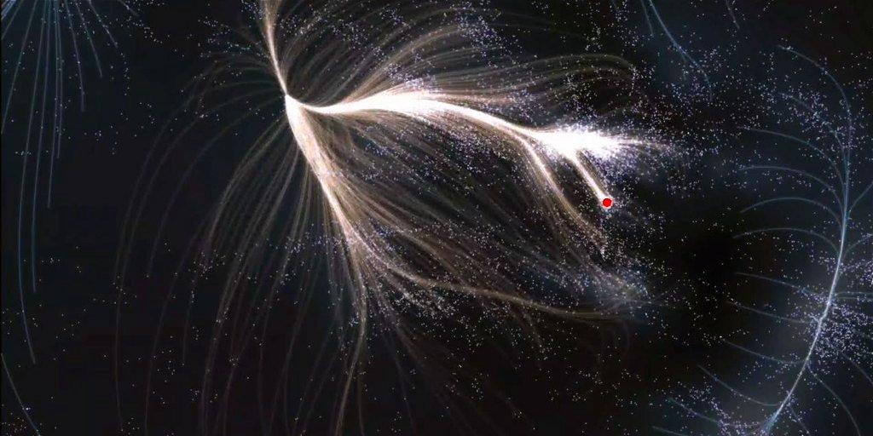
The Rise of Statistics and Informatics in Astronomy
Astronomy is entering the cyber age. Astrostatistics and astroinformatics are burgeoning enterprises with rapid growth in the astronomical research literature, cross-disciplinary meetings, new textbooks, and attention by scholarly societies. These trends are responding to the proliferation of large-scale imaging, spectral and time domain data. Advanced computational and statistical analysis techniques are essential to analyzing our increasing data flow and realizing our endeavor to characterize and understand cosmic phenomena. The Astrostatistics and Astroinformatics Portal (http://asaip.psu.edu) is a Web site serving the cross-disciplinary communities of astronomers, statisticians and computer scientists. It is intended to foster research into advanced methodologies for astronomical research, and to promulgate such methods into the astronomy community. (https://www.journals.elsevier.com/astronomy-and-computing)

Slide 6
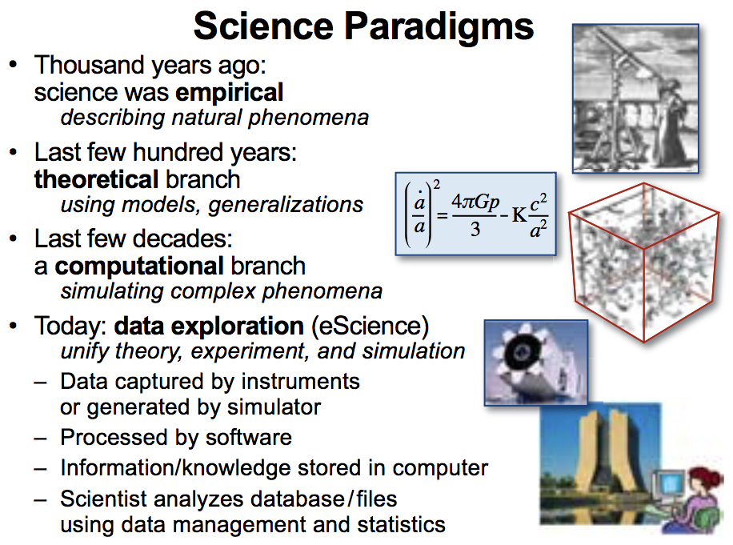
https://www.microsoft.com/en-us/research/publication/fourth-paradigm-data-intensive-scientific-discovery/

Slide 7
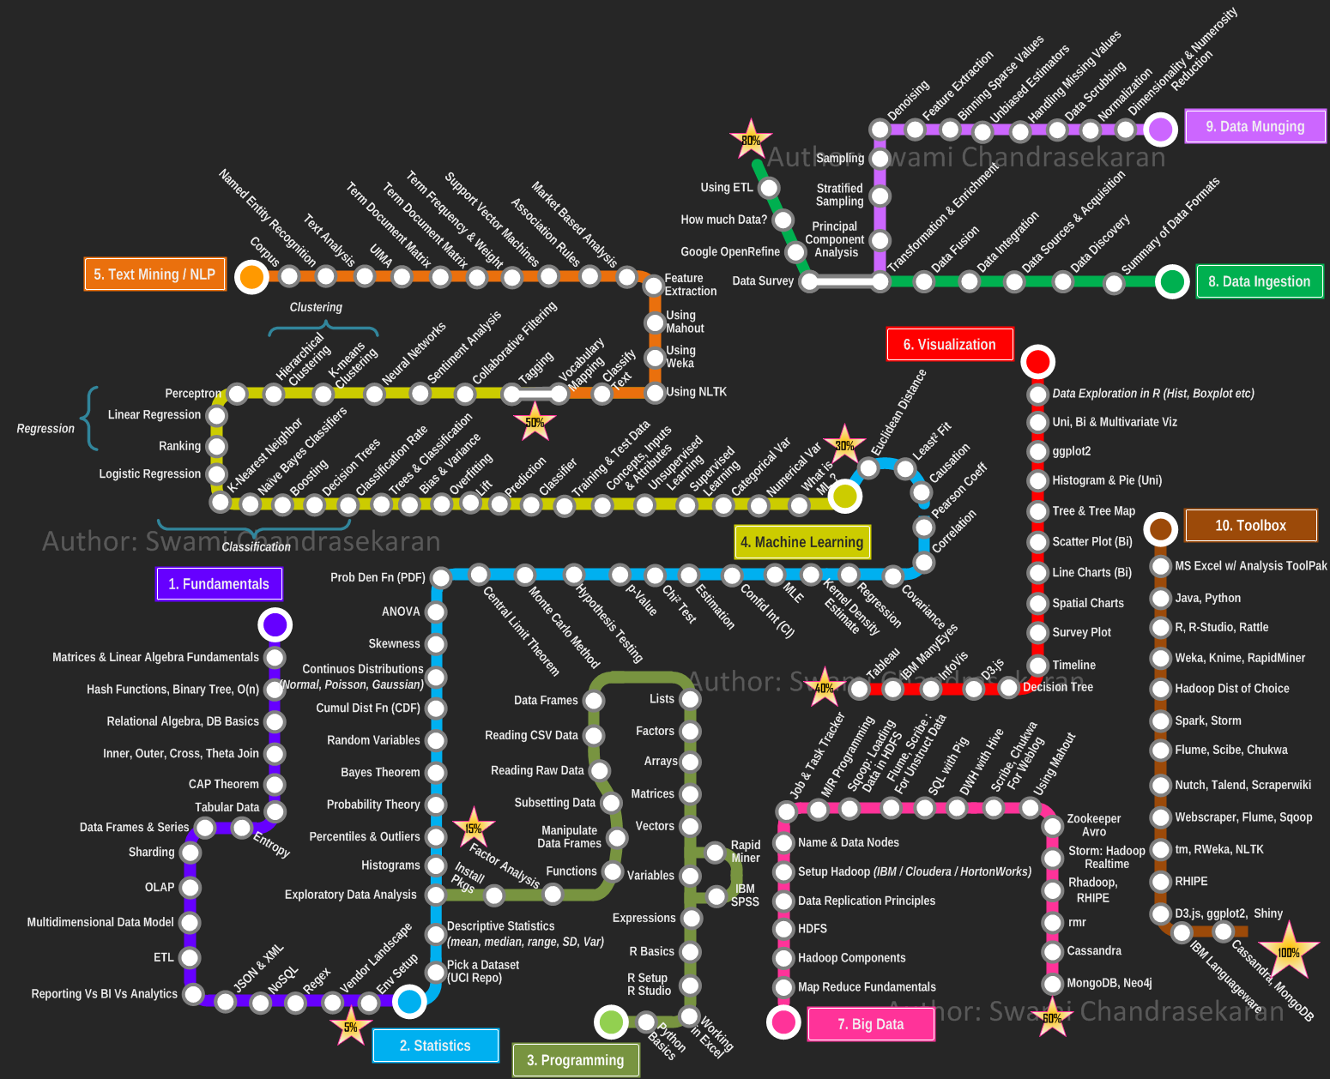
The comunities involved ranged so far: Machine Learning, Statistical Learning, Artificial Intelligence, Multivariate Statistics, Data Mining, Database, Big Data, Computer Vision, Visualization, Information Theory.

Slide 8
Probabilidad:
Seeing Theory book:
https://seeing-theory.brown.edu/
Google Colab Notebooks:
https://colab.research.google.com/drive/1Hstxe2Q6yv6EgjdfTH7_7tGPeYOwb5c_?usp=sharing

Slide 9
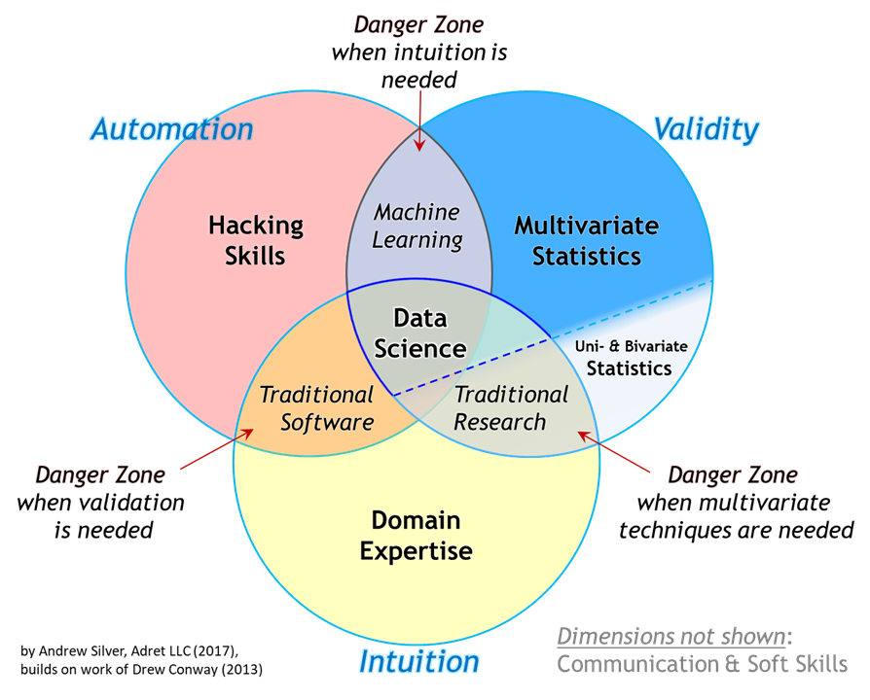

Slide 10
An incomplete survey of the relevant literature:
– Numerical Recipes 3 by Press, Teukolsky, Vetterling and Flannery.
– The Elements of Statistical Learning: Data Mining, Inference and Prediction by Hastie, Tibshirani
and Friedman.
– Modern Statistical Methods for Astronomy with R Applications by Feigelson and Babul.
– Information Theory, Inference and Machine Learning Algorithms by Mac Kay.
– Pattern Recognition and Machine Learning by Bishop.
– Artificial Intelligence by Russell and Norvig.

